Slide 1
Student Lifecycle Management System
SLCM Presentation

Slide 2
Content SLCM
Admission
Admission Master
Student Admission Process
Fee Management
Student Program Enrollment Process
Academics
Student Group Creation
Student Course Scheduling (Time Table)
Student Attendance
Mentor Mentee Communication
Examination
Exam Declaration
Paper Setting
Student Exam Application
Evaluation Process
Certificate Generation

Slide 3
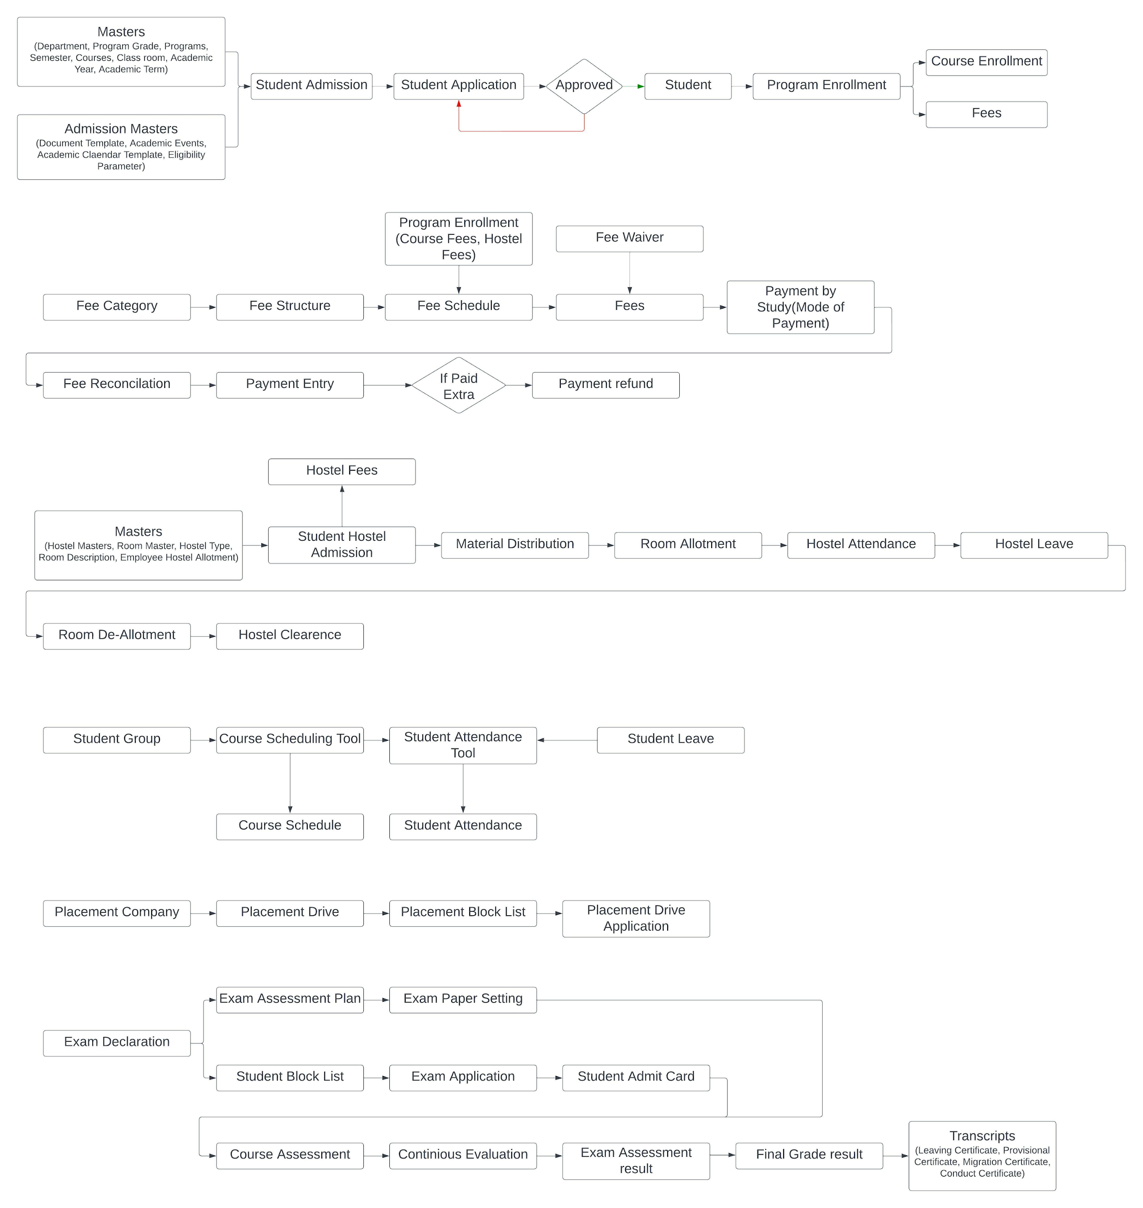
Admission Flowchart

Slide 4
Admission
Admission Master
Department
Programs
Semester
Course
Academic Calendar
Document Template
Instructor
Instructor Log

Slide 5
Admission
Student Admission Process
Student Admission Template
Student Applicant
Student Creation

Slide 6
Admission
Fee Management
Fee Type
Fee Structure
Fee Schedule
Fees

Slide 7
Admission
Student Program Enrollment
Program Enrollment
Course Enrollment
Program Re-registration Tool

Slide 8
Academics Flowchart

Slide 9
Academics
Student Group Creation
Creating Student Group on the basis of Activity, Examination, Course, Batch.
Instructor Connection
Course Scheduling (Time Table)
Course Scheduling Tool
Course Schedule
Time Table (Calendar View)
Attendance
Student Attendance Tool
Student Attendance
Mentor Mentee Communication
Mentor Allocation
Mentor Mentee Communication

Slide 10
Examination Flowchart
Certificate Generation
Exam Declaration
Exam Application
Exam Evaluation Plan
Student Admit Card
Cumulative Marksheet
Exam Paper Setting
Criteria Wise Evaluation
Continuous
Evaluation
Semester Wise Exam Result
Back Paper Tracking

Slide 11
Examination
Exam Declaration
Exam Evaluation Plan
Student Exam Application Form Fillup
Student Admit Card
Mark Uploading
Term Wise Result Publishing
Cumulative Marksheet
Certificate Generation

